Slide 1
WebAssembly With Rust
Robert Hanson
https://github.com/kimtuck/webassembly
Notes:
(intro – sdg, 10 years best place to work in the twin cities) I have done some cool things recently: 50 mile run, 100 mile bike, and this presentation. So in that spirit

Slide 2
Please share
Share what you learn. And the best time to share is while you’re learning it.
—Jeremy Keith, author of Going Offline and HTML5 For Web Designers
All of us here are doing something cool; consider sharing it!

Slide 3
What we will talk about
What is WebAssembly
What is Rust
Installation / getting started
Some examples

Slide 4
Motivation
Shiny Objects!!! With Rust!!!
WebAssembly is new.
Chrome – Mar 8 2017 Edge – Oct 16 2017 FireFox – Apr 18 2017 Safari – Sept 18 2017 WebAssembly has been viable for about 12 months.
Rust is new. Not really, but new to me.
Rust won first place for "most loved programming language" in the Stack Overflow Developer Survey in 2016, 2017 and 2018
Rust can compile to WebAssembly (and lots of other targets too)
Notes:
Web assembly and Rust are both pretty new. Saw Rust at last year’s MidwestJS and thought it was very exciting
Why – binary compatibility with multiple OS/languages/runtimes Why – ownership model, no garbage collection, no nulls
Then I found out you can target web assembly

Slide 5
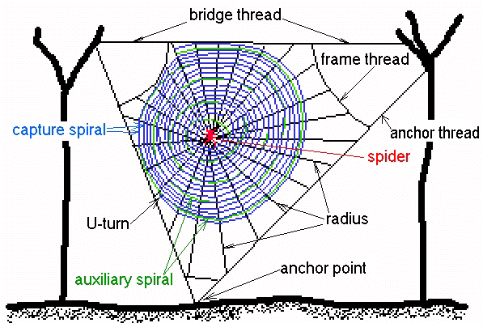
WebAssembly

Slide 6
What is WebAssembly
http://webassembly.org/
WebAssembly (abbreviated Wasm) is a binary instruction format for a stack-based virtual machine. Wasm is designed as a portable target for compilation of high-level languages like C/C++/Rust, enabling deployment on the web for client and server applications.
Let’s break this down…

Slide 7
What is WebAssembly
Compilation target
Binary format (with a textual representation in dev tools)
The compiled file (.wasm) is an asset; it’s part of your site like a .js file or .png
Loads fast
Runs at native speed
Single-threaded (same as UI thread)
Can be loaded into webworker, service worker
Interop with javascript

Slide 8
WebAssembly
Use it for things you don’t want to do in JS
A physics engine (gaming!) Image processing A CPU emulator A synthesizer Render CAD drawings
Because JS sucks at these types of applications
And there are probably already Rust (or c, or c++) libraries

Slide 9
What can you do with WebAssembly?
Protect your core business logic
Compute intensive operations (games, face recognition)
Encryption

Slide 10
High level language options
You don’t typically write webassembly code by hand. Some languages are well-suited for compiling to webassembly code
Requirements: No garbage collection; no exceptions;
Rust
C, C++ -- emscripten
Lots of other languages https://github.com/appcypher/awesome-wasm-langs

Slide 11
Javascript API
You can read the description if you want.
https://developer.mozilla.org/en-US/docs/WebAssembly/Using_the_JavaScript_API
Webassembly spec defines only two integer types and two floating point types.
Webassembly spec talks about “memory”, “tables” etc
Can’t directly interact with the DOM or canvas. But you can call a js function to do that work.
There is a tool, wasm-bindgen, that writes glue code for us.

Slide 12
Javascript API and wasm-bindgen
Wasm functions can be called from js; can call js.
You currently need “glue code”
to marshal parameters and convert function return values.
Wasm-bindgen automatically generates the glue code, by inspecting your Rust code. -- compiler directives/macros tell wasm-bindgen what code to process -- it’s mostly magic
It provides both rust and javascript code, so that you can write “dom manipulation” code in Rust.

Slide 13

Rust

Slide 14
Rust
Rust provides an easy path to webassembly. Directly compiles to webassembly,
Rust appears to have a lot of traction
It’s early yet; it is possible that some other language will emerge.

Slide 15
Rust language features
No garbage collection
No exceptions
Guaranteed memory safety; no null/dangling pointers
Ownership, borrowing
Easy unit testing
Fearless threading
Higher-level language constructs, generics, traits.
Npm-like open source packages – “crates” and “cargo”
Comprehensive build system
Native code for many environments

Slide 16
Rust is ideal for WebAssembly
No garbage collection, no exceptions
With wasm-bindgen, javascript interop is straightforward
Higher-level language constructs -- structs, (classes) strings, lists
Generics
Threading (when webassembly supports threading)

Slide 17
Learn more about Rust
This is not an introduction to Rust.
https://www.Rust-lang.org

Slide 18

Installation

Slide 19
Installation
Install node/npm
And, a C++ compiler is required Windows users: can use free compiler tools from MS
Install webpack (just for this demo) npm install --save-dev webpack webpack-cli

Slide 20
Installation
Install rust: https://www.rust-lang.org/en-US/install.html Use default installer values (1)
Open command prompt in your project directory
$rustup default nightly
$rustup target add wasm32-unknown-unknown --toolchain nightly
In each project: $ cargo +nightly install wasm-bindgen-cli --force

Slide 21
Installation
rustup update
cargo update
npm run build
npm run serve

Slide 22
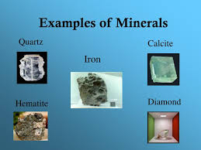
Examples

Slide 23
References
Rust: https://www.rust-lang.org
WebAssembly: https://webassembly.org
Wasm-bindgen: https://github.com/rustwasm/wasm-bindgen
https://hacks.mozilla.org/2018/04/javascript-to-rust-and-back-again-a-wasm-bindgen-tale/

Slide 24
I’m Robert Hanson, and thanks for listening!

